Slide 1

Job Market Analysis and Recommendation System
Presented by
Priyanka verma

Slide 2
Objective
The primary objective of this project is to analyze job market trends and build a recommendation system for job seekers based on real-time data. The system will help in identifying high-demand job roles, salary trends, and emerging job categories, and will provide personalized job recommendations.

Slide 3
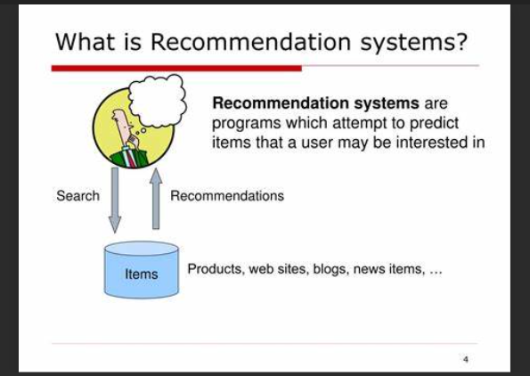
What is Recommendation System ?

Slide 4
Required Tools
● Data Sources: The data can be accessed from upwork.com
● Analytics Tools: Python, SQL, Pandas, Scikit-Learn, and TensorFlow
for machine learning models.
● Visualization Tools: Matplotlib, Seaborn, Plotly for interactive graphs.
● Web Development: Flask or Django for API development.
● Containerization: Docker for deploying and managing application
containers.

Slide 5
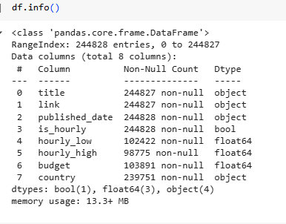
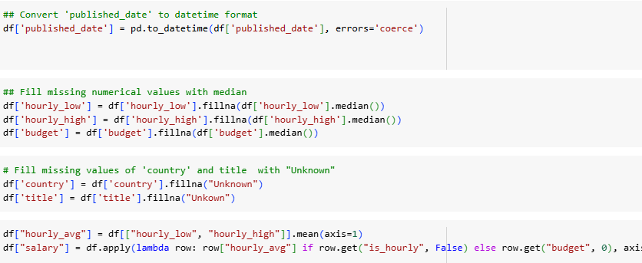
Data Overview
rows 244828
Columns 8
data preprocessing

Slide 6
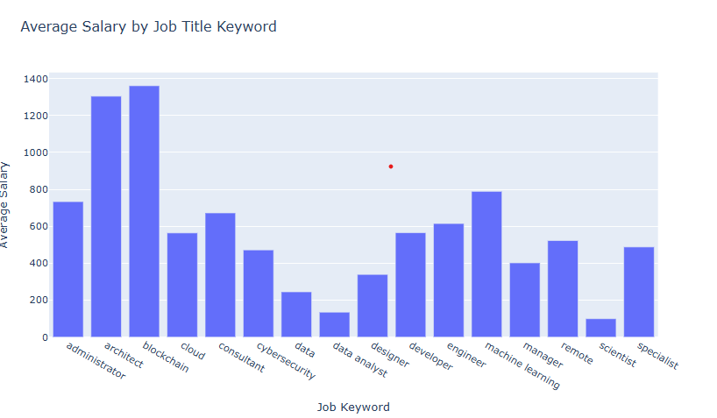
Task 1: Analyze the correlation between job title keywords and offered salaries
Job Seekers: Professionals should aim to upskill in high-demand areas like blockchain, architecture, and machine learning to improve earning potential.
Employers & Recruiters: Companies looking for specialized talent in high-paying roles must be ready to offer competitive salaries.
Career Planning: Individuals entering the job market should consider focusing on skills that align with higher-paying job keywords.

Slide 7
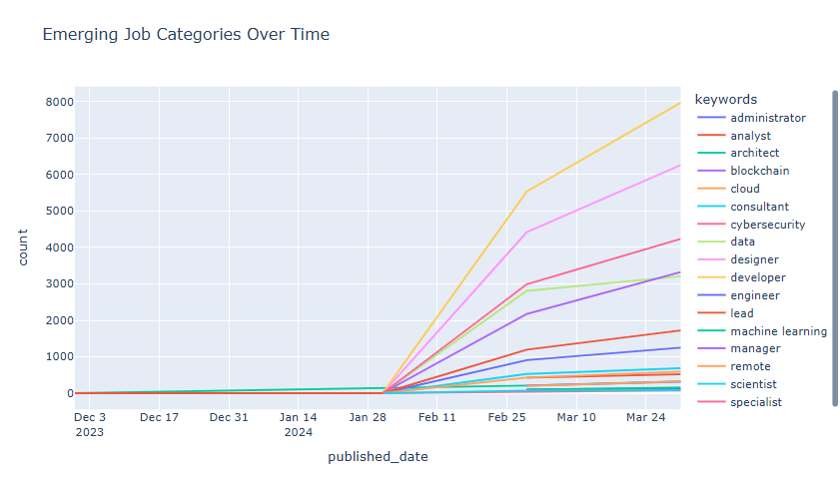
Task 2: Identify emerging job categories based on posting frequency
1.Rapid Growth in Certain Job Categories:
*The keywords with the steepest upward trend indicate high demand and rapid growth.
*The most emerging job categories appear to be related to cloud, blockchain, and machine learning, as they have seen the most significant increase in job postings.
2.Consistent Increase Across Multiple Categories:
*Job roles like analyst, engineer, consultant, and developer are also growing steadily, indicating a consistent demand over time.
*This suggests that these roles remain essential in the job market, and their demand is expected to continue.

Slide 8
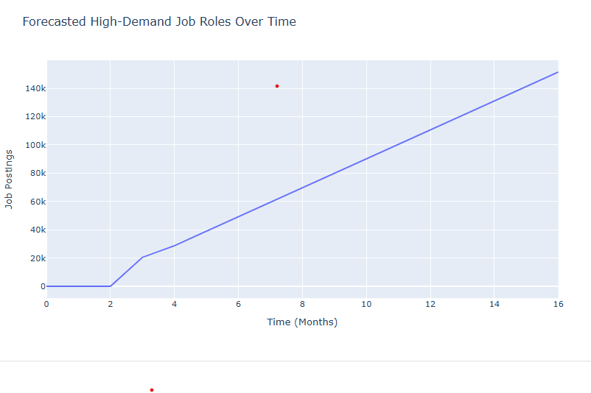
Task 3: Predict high-demand job roles by analyzing job posting patterns over time
*The forecasted job postings show a steady increase over time, indicating that demand for jobs is expected to grow in the future.
*This suggests a positive job market outlook, where more positions are likely to become available.

Slide 9
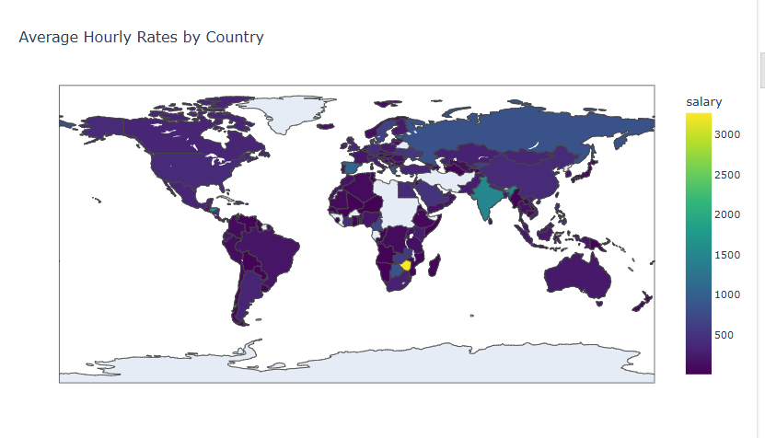
Task 4: Compare average hourly rates across different countries
1.Variation in Salaries Across Countries
*The map shows significant differences in average hourly salaries across different regions.
*Some countries have higher salaries (yellow-green shades), while others have lower salaries (dark purple shades).
2.High Salary Regions
*Countries with high average hourly wages are marked in yellow-green, likely representing regions such as North America, Western Europe, and Australia.
*These areas typically have strong economies, higher living costs, and developed job markets.

Slide 10
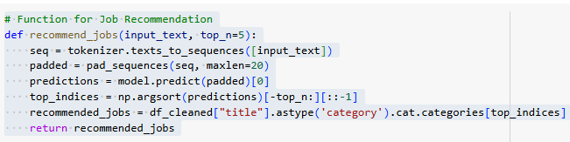
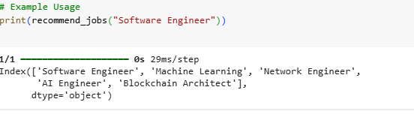
Task 5: Create a job recommendation engine based on current job postings

Slide 11
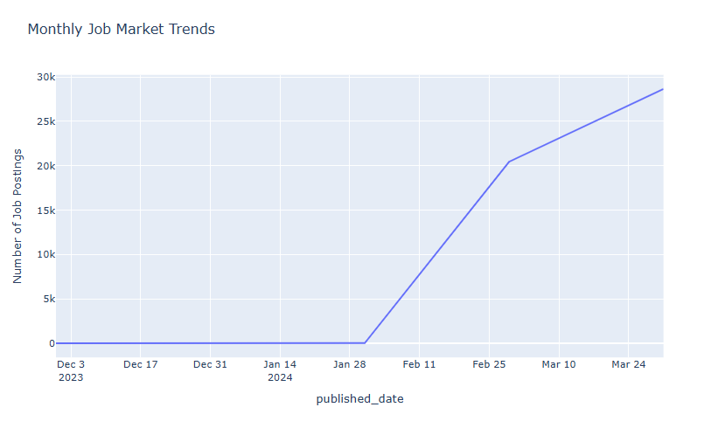
Task 6: Track changes in job market dynamics over months
1.Steady Growth in Job Postings
*The number of job postings has significantly increased over time.
*Initially, from December 2023 to late January 2024, job postings were minimal or absent.
*From February 2024 onwards, there's a sharp and continuous increase in job postings.
.
2.Future Predictions
*If the trend continues, March and April may see even higher job postings.
*The job market is currently in an expansion phase, which is beneficial for job seekers.

Slide 12
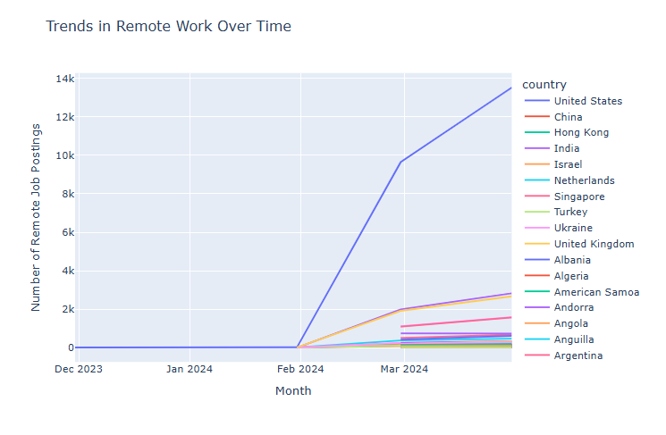
Task 7: Investigate trends in the remote work landscape
1.Increase in Remote Job Postings
*Initially, from December 2023 to late January 2024, there were very few remote job postings.
*Starting in February 2024, remote job postings increased significantly.
*The United States (blue line) has the highest number of remote job postings, followed by a few other countries like Netherlands, Israel, and the United Kingdom.
2.Possible Reasons for the Trends
*Post-Pandemic Job Market: Companies continue to offer remote work options due to changing work culture.
*Tech and IT Sector Growth: Many remote jobs are tech-related, and the US dominates the IT sector.
*Global Hiring Trends: Companies may be hiring remote workers from different countries to tap into global talent.

Slide 13
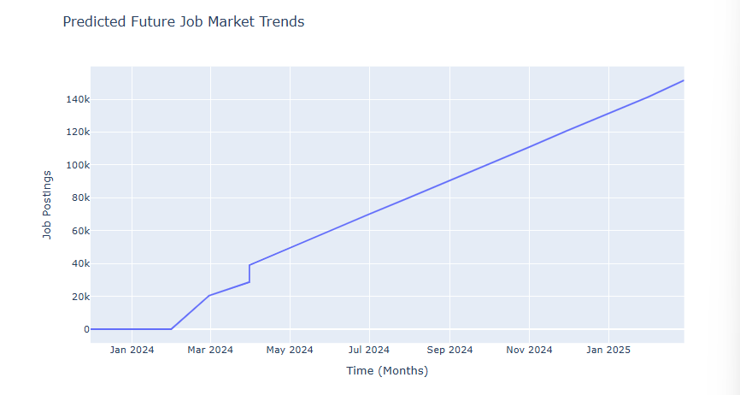
Task 8: Predict future job market trends
1. Overall Trend
The graph represents predicted job postings over time from January 2024 to early 2025. Initially, job postings were very low, but around March 2024, there is a sharp increase. After March 2024, the number of job postings steadily rises in a linear trend, reaching over 140k job postings by early 2025.
2.Possible Causes for the Growth
📌 Economic Recovery & Business Expansion → Companies expanding hiring post-recession/pandemic.
📌 Increase in Remote & Tech Jobs → More businesses adopting flexible/remote work options.
📌 Government Policies & Investments → New policies stimulating job creation.
📌 AI & Automation Impact → Companies may create new jobs while automating others.

Slide 14
Conclusion
The project focuses on analyzing the dynamic job market, which is affected by technology, economics, and cultural trends. It aims to use data analytics to develop a recommendation system that offers insights based on historical and current job postings. This will assist job seekers and recruiters in making informed decisions.

Slide 15

This Photo by Unknown Author is licensed under CC BY-SA

